Slide 1
Welcome to the Course!
Notes:
Data is all around us. We all both generate and use data to make our lives better. Businesses and governments use data to make better decisions that affect us every day. Much of the data, however, is unused because organizations do not have the tools and knowledge to capture, aggregate, model, and transform the data into useful knowledge. Data alone is meaningless; it is contextless. Splunk is one of the most powerful data engineering tools available. It allows organizations to turn data into real value, and in this course, you will learn all you need to know in order to bring that value to any organization.
This course is for you if:
You are curious about data and how to derive value from it
You’ve inherited a Splunk Enterprise environment and aren’t sure how to get started
You’ve been asked to find a way to get value out of your organization’s data (using Splunk, hopefully)
Everyone!

Slide 2
Welcome!
Welcome to the course!
How to be successful
What is Splunk?
Architecture and extending Splunk Enterprise
Splunk Cloud Platform
Notes:
Hey everyone and welcome! I am excited to be working with you in this course!
This course is divided up into sections, and in this the first one—the beginning of your journey—we will talk first and foremost about how to be successful.

Slide 3

Obligatory Slide
MS, Information Systems
University lecturer
Splunk Certified Administrator
Online course author
Industry practitioner (20 years)
© Adam Frisbee, adamfrisbee.com

Slide 4
Course Success
Notes:
Let’s talk about how to be successful in this course. I want you to get the most possible out of this course.

Slide 5
Splunk Every Day
5 Minutes
Success!
Follow along
Quizzes: 100%
© Adam Frisbee, adamfrisbee.com
Notes:
There are four parts to being successful in this course
Splunk every day
Commit to five minutes of this class every day
Don’t move on to the next section until you pass the current sections quiz with 100%
Follow along with the demos, build a home lab or use the Splunk Cloud Platform trial.

Slide 6



Downloadable slides
Homework
Official Splunk documentation
© Adam Frisbee, adamfrisbee.com
Notes:
Resources:
All slides are downloadable. You should download them and follow along with the lectures.
Homework and quizzes are made available for checks on your learning. Complete them.
Refer to the official Splunk documentation for anything and everything related to Splunk.

Slide 7

Getting Help
Splunk Community
community.splunk.com
Splunk documentation
docs.splunk.com
Course Q&A
Notes:
You will get stuck from time to time. Luckily, there are places to get help.
The Splunk community will never let you down. Especially the Splunk Answers section. This is a Stack Overflow format question and answer community, except no one is rude. You can ask any Splunk question from absolute beginner questions to the most advanced questions. I’ve never had any of my questions go unanswered for longer than a few hours. Splunk pros hang out there.
We have a vibrant community here on Udemy where you can post questions and answer others’ questions. I’ll pop in there from time to time, but in a community with ten—of-thousands of students, I obviously can’t answer every question.

Slide 8

Course Rating
Rating courses is very helpful to instructors. Please take a minute to rate this course.
© Adam Frisbee, adamfrisbee.com

Slide 9
What is Splunk?
Notes:
Splunk is a huge platform with vast data capabilities spanning multiple products and services. It can be confusing, but by completing this course, you’ll have an understanding of which products to use for specific use cases.
Splunk began as machine data processing software and has since expanded into the number one platform for business analytics, security and incident event monitoring (SIEM), the more advanced SOAR (security orchestration, automation, and response), data science (machine learning, predicting, artificial intelligence), behavior analytics, IT operations and much more.
But don’t become overwhelmed. This course is for beginners, and as such we will focus on the Splunk basics and Splunk core products, which are ingesting and processing all kinds of data and making it useful for the enterprise.

Slide 10
What is Splunk?
Structured data
Unstructured data
Network events
HTTP
Custom and vendor specific
Files
API
© Adam Frisbee, adamfrisbee.com
Notes:
At it’s core, Splunk is a data platform.
Hidden in your organization’s data is a gold mine of useful, actionable knowledge. Data is generated by everything in the modern world—humans generate data by their actions (web clicks, purchases, logins, everything they do). Machines generate data because they record literally everything they do and everything that happens to them. Things like syslogs, application logs, and other metrics.
Splunk takes this data--any type of data: unstructured, structured, machine generated, human generated--and allows you to create real value from that data in the form of rich reports, live dashboards, and triggered alerts

Slide 11
What is Splunk?
Structured data
Unstructured data
Network events
HTTP
Custom and vendor specific
Files
API
Dashboards
Reports
Alerts
Actions
© Adam Frisbee, adamfrisbee.com

Slide 12
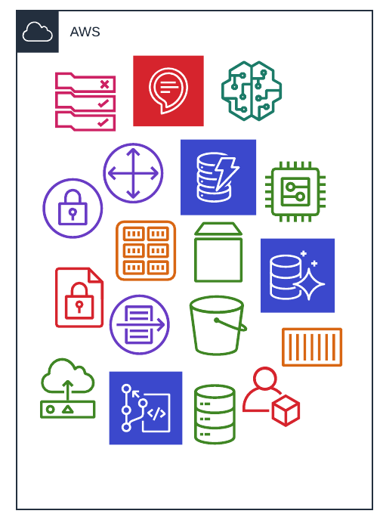
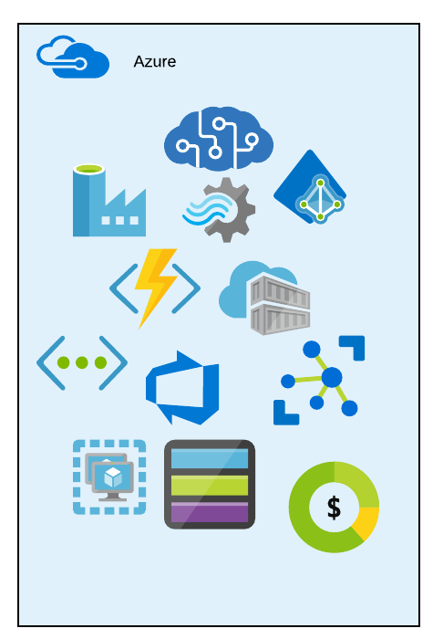
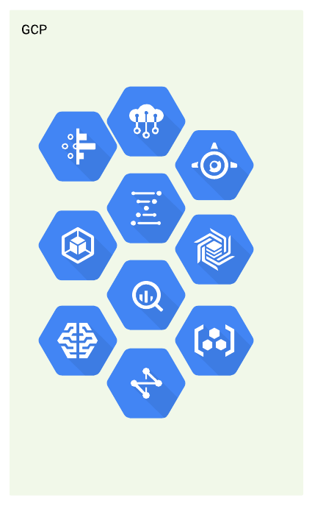
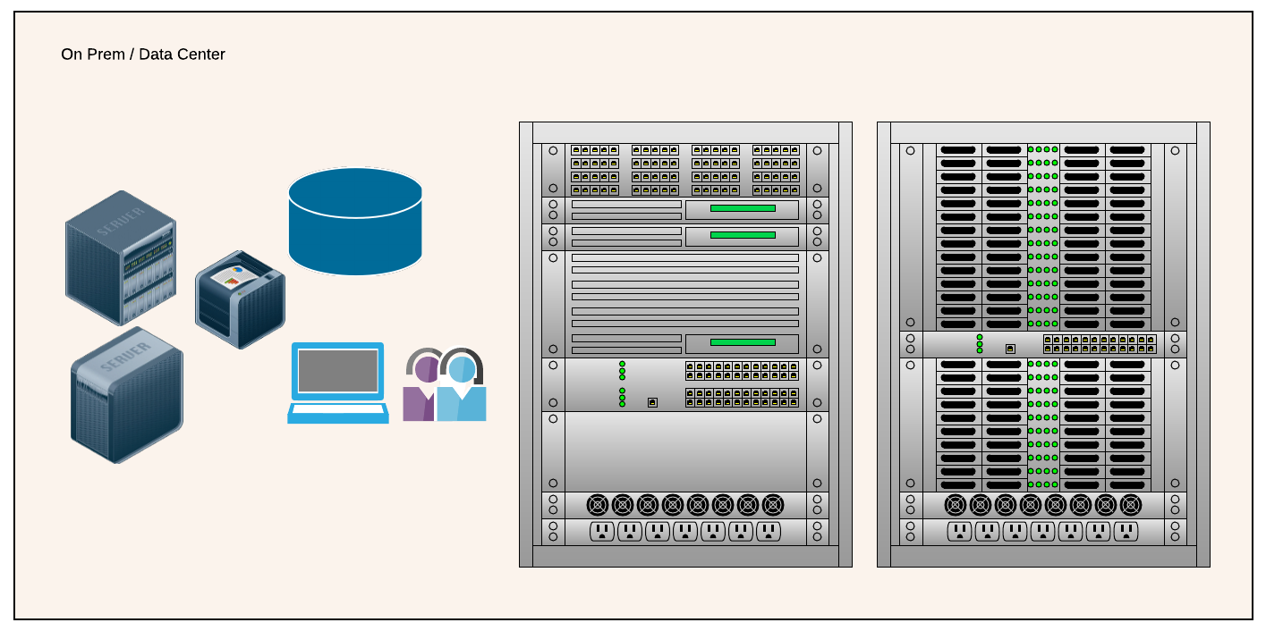
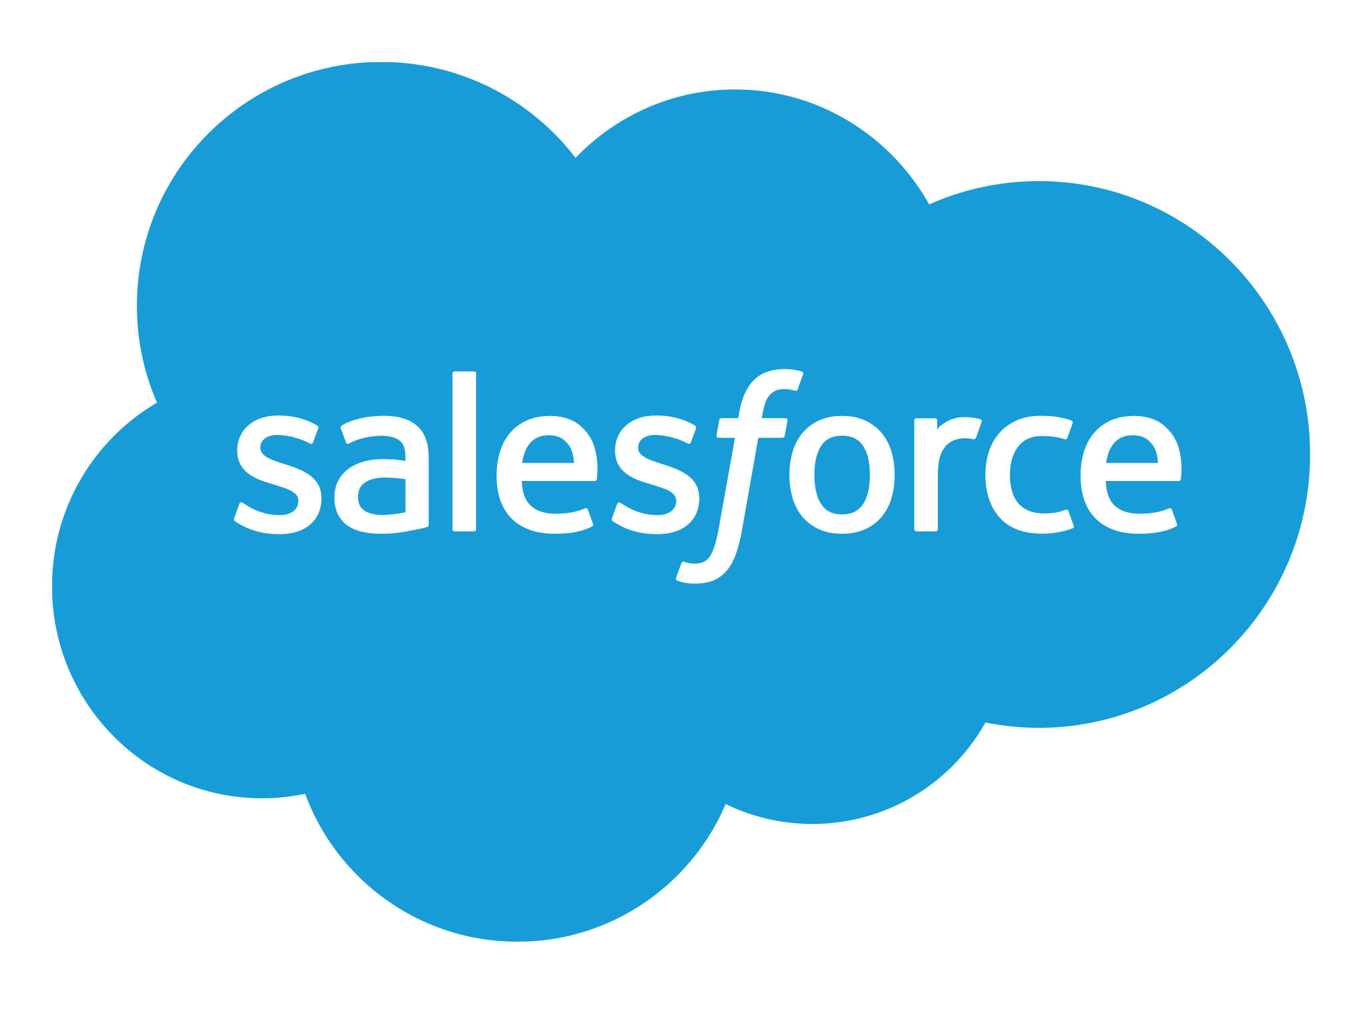


What is Splunk?
© Adam Frisbee, adamfrisbee.com
Notes:
Consider a typical, modern organization. It might have some assets in various cloud providers: perhaps Microsoft 365 with EntraID, and maybe a few other Azure services. It might have some big data solutions built out in GCP, and some infrastructure in AWS. Most organizations also use PaaS or SaaS services, too like Salesforce and ServiceNow. It likely also has on premises assets like laptops, desktops, physical servers, physical storage, networking gear, and so on.
Each and every one of these items knows and can log exactly what happens to it at any given moment. It logs incoming requests, outgoing messages, users and other systems with which it interacts, actions it takes and much, much more. Anyone who has sifted through a log file export knows what I am talking about.
But what generally happens to all of this data? It gets dumped into a veritable black hole. Nobody looks at it or cares about it until there is a problem. Then, IT pros are left with manually searching through tens-of-thousands, hundreds-of-thousands, and sometimes millions of log entries trying to investigate the situation.

Slide 13
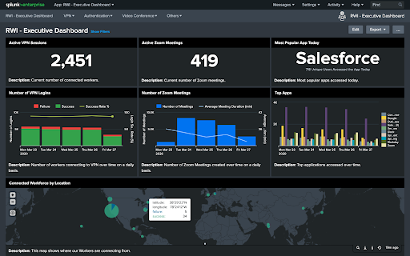

What is Splunk?
>
© Adam Frisbee, adamfrisbee.com
© Adam Frisbee, adamfrisbee.com
Notes:
Friends, there’s a better way.
With Splunk, we can set up a system to capture this data, clean it, format it, transform it, and derive business value from it!

Slide 14
What is Splunk?
PChUkRtaKKnCoRCZ7ryyUbUJ0E4koARasE9RATt9j7a
G0usmzJ7BPKuaEcpy puP1U9q8PHMmeu9VLd3CNE
Qu5XFinVEDRhbASc17BwvKTnkbqkzFSWudhR7W
np4NR13iy6XPuhOjiiIX8SZXlx60l7323twWecHm
uxtgbyxKaLXB3FMfp3pGADdt3mWQ24LMF7g1gW5L
system_name
system_state
system_geo
© Adam Frisbee, adamfrisbee.com
Notes:
We can also train Splunk on your data!
Splunk is great at reading and parsing machine data, but it’s much more than that. It’s a fully fledged BI tool, data analytics tool, SIEM/SOAR tool, data science tool, and more!
For just one of it’s super powers, consider machine data:
Typical data generated by machines (and by machines I mean systems of any kind: cloud or on prem, containers or virtual or physical systems, vehicles and IoT devices, etc.) generate data that is cryptic. That is to say that it is not human friendly. It looks similar to this. An unreadable mess—unreadable by humans, that is.
With Splunk, we can train it to look for certain patterns called “regular expressions” and then label those patterns as fields. We can then take those fields and build intelligence systems that show us the data in an understandable way.
That’s what this class is all about. Can you imagine how valuable someone with this skillset is in the workforce? That’s why you enrolled in this class, and together, we are going to boost your resume!

Slide 15
What is Splunk?
PChUkRtaKKnCoRCZ7ryyUbUJ0E4koARasE9RATt9j7a
G0usmzJ7BPKuaEcpy puP1U9q8PHMmeu9VLd3CNE
Qu5XFinVEDRhbASc17BwvKTnkbqkzFSWudhR7W
np4NR13iy6XPuhOjiiIX8SZXlx60l7323twWecHm
uxtgbyxKaLXB3FMfp3pGADdt3mWQ24LMF7g1gW5L
system_name
system_state
system_geo
PChUkRtaKKnCo | P1U9q8PHMmeu9 | uxtgbyxKaLXB3
© Adam Frisbee, adamfrisbee.com
Notes:
Splunk is great at reading and parsing machine data, but it’s much more than that. It’s a fully fledged BI tool, data analytics tool, SIEM tool, data science tool, and more!
For just one of it’s super powers, consider machine data:
Typical data generated by machines (and by machines I mean systems of any kind: cloud or on prem, containers or virtual or physical systems, vehicles and IoT devices, etc.) generate data that is cryptic. That is to say that it is not human friendly. It looks similar to this. An unreadable mess—unreadable by humans, that is.
With Splunk, we can train it to look for certain patterns called “regular expressions” and then label those patterns as fields. We can then take those fields and build intelligence systems that show us the data in an understandable way.
That’s what this class is all about. Can you imagine how valuable someone with this skillset is in the workforce? That’s why you enrolled in this class, and together, we are going to boost your resume!

Slide 16
What is Splunk?
system_state
system_geo
PChUkRtaKKnCo | P1U9q8PHMmeu9 | uxtgbyxKaLXB3
system_name
Location
Web Server | Down | Denver, Colorado, USA
Name
State
© Adam Frisbee, adamfrisbee.com
Notes:
Then we can create a lookup table to make our reports and alerts even easier to understand for a wide audience.

Slide 17






Security
Splunk
Platform
IT
Observability
Developer tools
Apps and add-ons
Notes:
Splunk Products are categorized into six categories:
In this class, we will focus on the Splunk Platform, which is the core of Splunk. It includes Splunk Enterprise, Splunk Cloud Platform, Splunk Forwarders, and Splunk Cloud Services. We will also talk about apps and add-ons.
You do need to know, however, that Splunk has a lot of other products that work with Splunk Enterprise and Cloud Platform, but are purpose built for Security, IT Operations, Observability, Thousands of apps and add-ons, and a full suite of developer tools. You can find out detailed information about all of these in the Splunk docs (docs.splunk.com)

Slide 18
Architecture and Extending Splunk
Notes:
One of the greatest things about Splunk is its extensibility. This extensibility gives you almost endless possibilities!

Slide 19

Splunk Enterprise Architecture
Distributed system architecture
Modular components
Highly scalable
Notes:
Splunk follows common distributed system architecture best practices

Slide 20


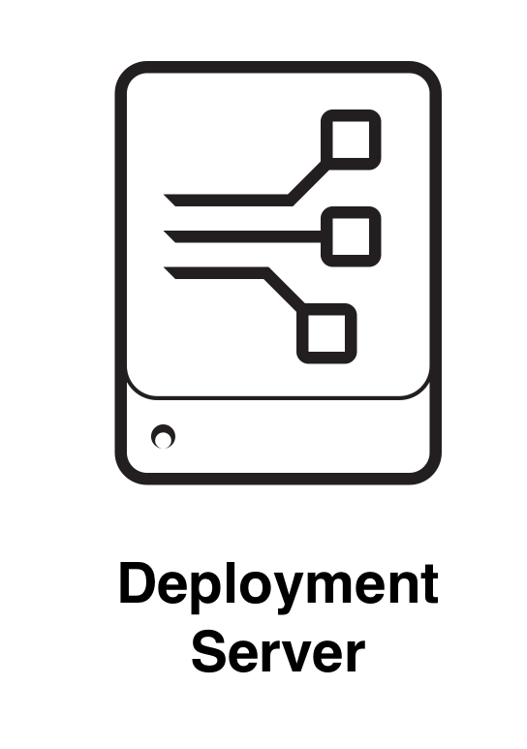
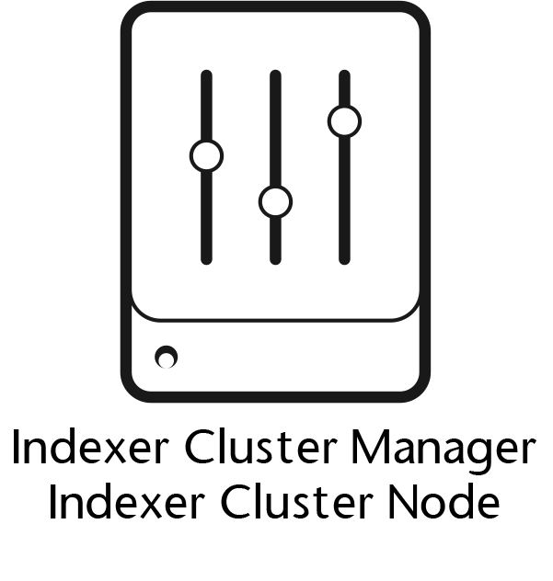
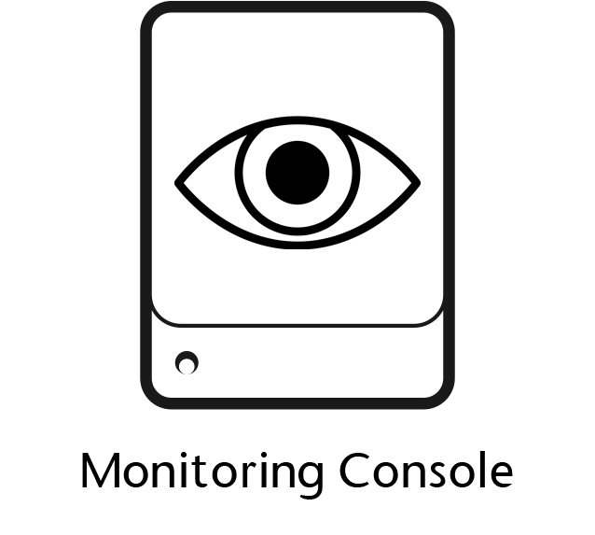

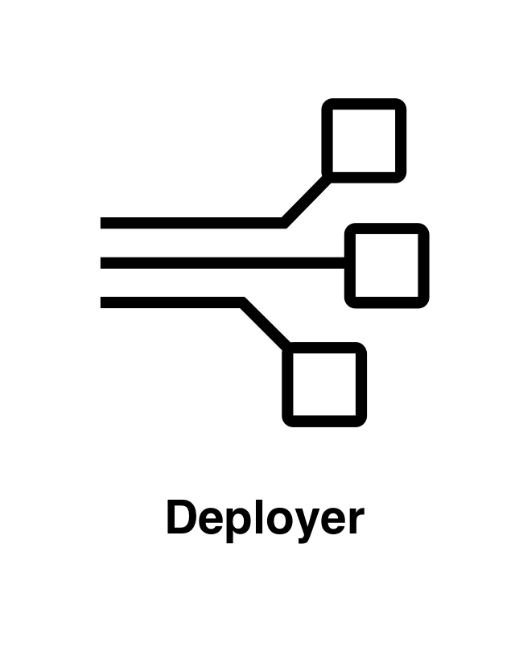
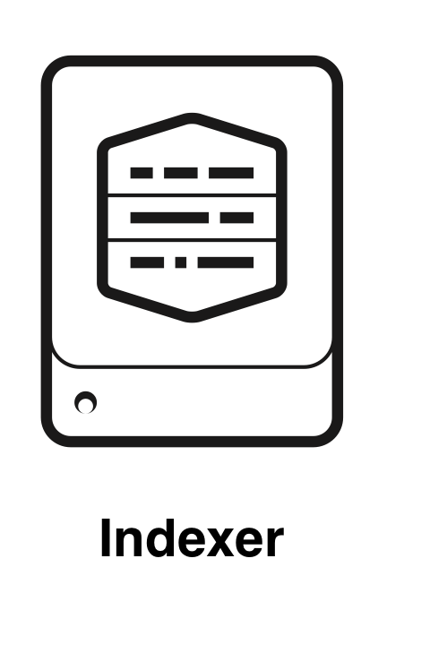
Splunk Enterprise Components
Processing
Management
License Manager
Notes:
The Architecture of Splunk Enterprise is built on Splunk Components. Components are simply instances of Splunk Enterprise (except Universal Forwarders) that are configured for a specific job. In this first discussion, I am going to talk about them at a high level, but we will dive more deeply into them throughout the course.
There are two broad categories of Splunk Enterprise components: Processing components handle the data, and Management components support the processing components and allow you and Splunk to manage the distributed system.
There are 3 processing components:
The Search Head handles all things search related, and in a small deployment, it will also host the web server that you log in to to use Splunk.
Forwarders simply move data from a source to an indexer or indexer cluster. There are universal forwards, which are lightweight agents that simply move the data, and heavy forwarders which are full installations of Splunk Enterprise, and they can do some data manipulations before forwarding the data to the indexers.
Indexers and indexer clusters receive the data from forwarders and transform it into Splunk events, then places those events in an index, which is a storage bucket in Splunk.
There are 5 management components to a Splunk Enterprise deployment.
The indexer cluster manager and indexer cluster node are components of indexer clusters, the manager manages the cluster and the node is one of the indexers in the cluster.
The monitoring console is a set of dashboards and health checks that are included in Splunk Enterprise. It provides insights into your deployment.
I’m going to skip down to the license manager, which is pretty self-explanatory. In a distributed deployment, one of the components will be a license manager, which every other component registers with to consume its license.
Please do not get the deployment server and the deployer mixed up. The deployment server remotely configures and manages all of your distributed Splunk components, which are called deployment clients.
Finally, the deployer manages search head clusters.

Slide 21


A Very Basic Deployment
Splunk Web Interface
Data
Data
Data
Notes:
To show you a super simple, non distributed deployment of Splunk, here is one way those components can come together to make the Splunk system.

Slide 22
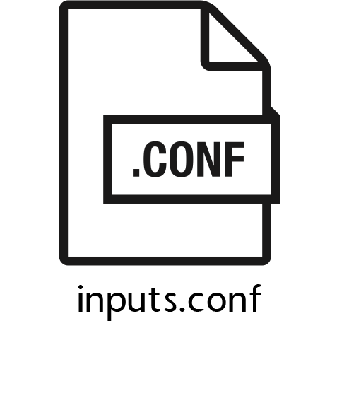
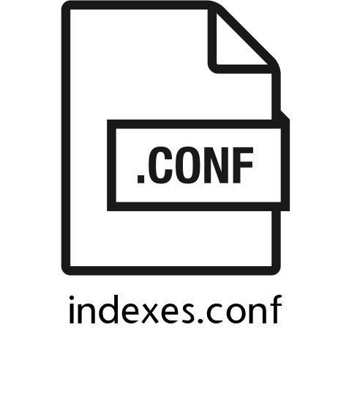
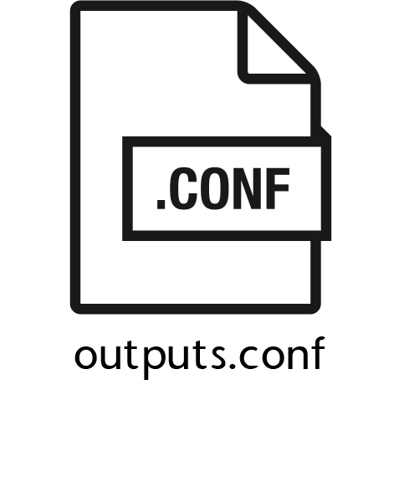
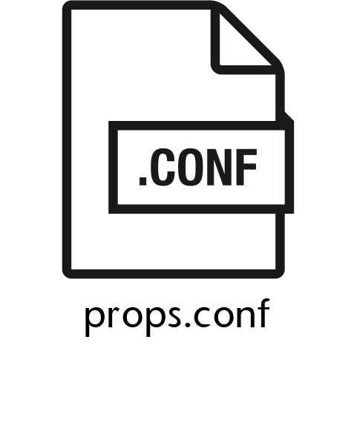
Splunk Configuration Files
[my_sourcetype]
KV_MODE = auto_escaped
CHECK_FOR_HEADER = true
Notes:
Behind the scenes, everything about Splunk is governed by sets of configuration (or .conf) files. These files contain system settings, authentication and authorization information, index related settings, deployment and cluster settings, knowledge objects, data models, saved searches, and other app-specific settings. We will talk much more about conf files later in the course.
The conf files that will be discussed in this class are listed here:
Inputs defines data inputs such as source types or files
Indexes manage index storage locations (buckets) and retention policies
Outputs manages data forwarding settings
Props manages things like timestamps and field extractions
Every setting you change in the Splunk UI is written to a config file. You can also edit config files manually in Splunk Enterprise, but not in Splunk Cloud.

Slide 23

Extending Splunk
Multiple products
Thousands of apps and add-ons
Splunkbase
Developer Tools
Build apps on Splunk
Custom data models and configuration files

Slide 24
Splunk Cloud Platform
Notes:
Welcome! I am so glad you’re here. Splunk is the most important enterprise software suite for data-geeks everywhere: from data engineers, data scientists, security professionals, to business intelligence professionals. Splunk is a BI tool and a SIEM (security information and event management) platform.

Slide 25
Splunk Cloud Platform
Splunk as a service
Benefits of Splunk Enterprise without having to manage the components and infrastructure directly
Updated and patched automatically by Splunk
Highly secure (Soc 2, ISO 27001, PCI, HIPAA, others…)
Recommended to create a free 14 day trial of Splunk Cloud to do many of the demos in this class

Slide 26
Introduction to the course
Who this course is for
How to be successful
Where to get help
Brief introduction to Splunk and what it can do
Multiple of products, thousands of apps, a lot of ways to extend Splunk
Training Splunk
Any type of data into insights
Extending Splunk
Basic architecture overview

